Slide 1
Business Insights
Unveiling Sales Trends & Market Performance
-Rupali Barhate

Slide 2
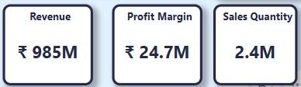
Executive Summary
Total Revenue: ₹ 985M
Profit Margin: ₹ 24.7M
Sales Quantity: 2.4M

Slide 3
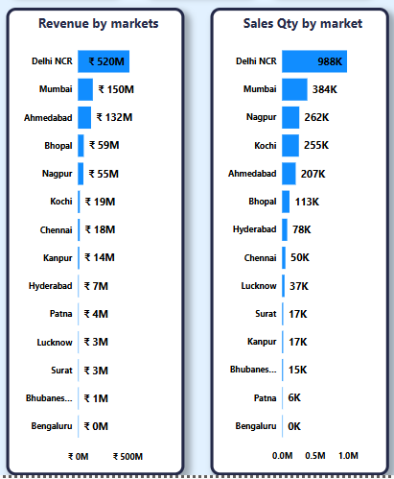
Key Insights:
Delhi NCR leads with ₹ 520M revenue.
Mumbai, Ahmedabad, and Bhopal follow.
Bengaluru & Bhubaneswar show limited sales impact.
Delhi NCR dominates in quantity with 988K units.
Kochi and Nagpur show strong sales numbers.
Chennai & Lucknow exhibit moderate demand.

Slide 4
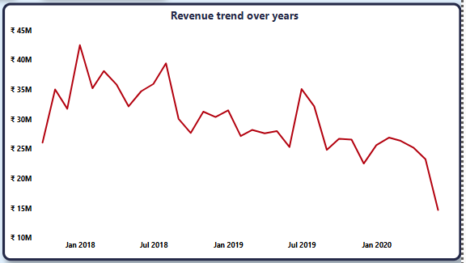
Key Observations from data
Steady growth between 2018-2019 indicates strong momentum and positive market adoption.
Sharp rise in Q4 months suggests seasonal influence—perhaps festive demand or year-end corporate purchases. A dip in early 2020 may align with external disruptions (e.g., economic slowdown or industry-specific.

Slide 5
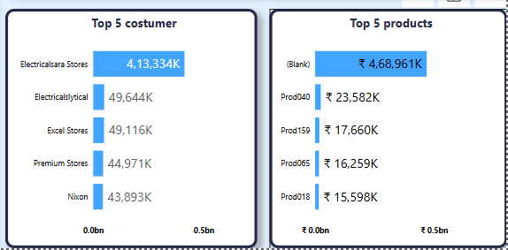
This slide highlights the key revenue-driving customers and high-performing products that contribute significantly to overall business success.
Key Insights:
Electrical Stores dominate as the top customer segment, driving the highest revenue, indicating strong demand for electrical products.
Prod040 & Prod159 emerge as the most profitable products, showcasing market preference and potential for expansion.
Consistent demand patterns among leading customers suggest opportunities to build deeper business relationships and optimize supply chain efficiency.

Slide 6
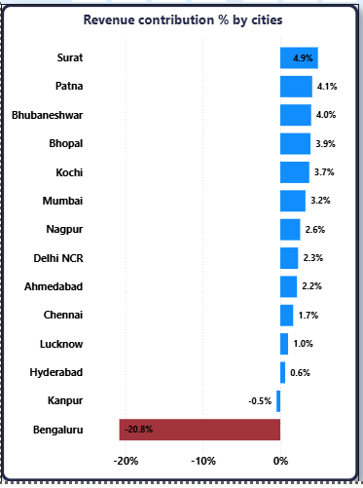
Revenue Contribution % by Cities
Cities like Surat (4.9%) and Patna (4.1%) are driving strong revenues, while Bengaluru shows a significant decline (-20.8%), highlighting market challenges.
This suggests an urgent need for targeted strategies—either improving engagement or analyzing demand patterns in weaker locations.

Slide 7
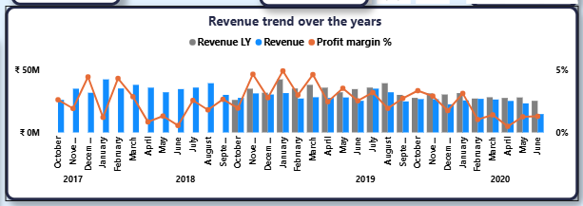
Tracking revenue trends from 2017 to 2020, we observe sustained growth between 2018-2019, with noticeable seasonal peaks. The downturn in early 2020 may indicate external disruptions—such as economic shifts or reduced consumer spending.

Slide 8
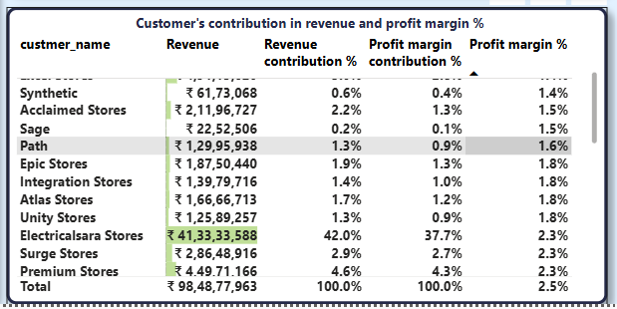
Electricalsara stores rank among the top revenue contributors, yet some have negative profit margins (-2.0%), raising cost efficiency concerns. The focus should be on reinforcing partnerships with high-margin customers while optimizing pricing strategies.

